Slide 1


…I am tensed…

Slide 2
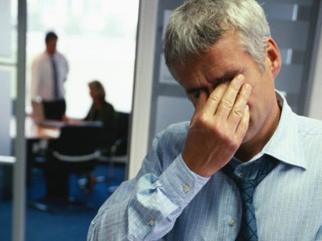
My mother is diabetic..
My father is heart patient……….

Slide 3

I have BP…..
My Blood Sugar is not under control !
I am worried …

Slide 4

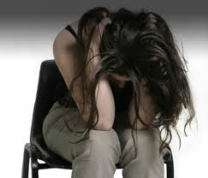

Too much Stress at work…
I often ignore health…. my wife, my son..

Slide 5

I often forget to take medicine !

Slide 6
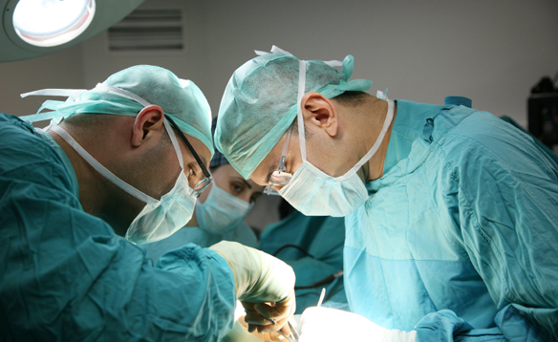
My father is Advised Surgery.
Looking for second opinion..
What should I do ?

Slide 7
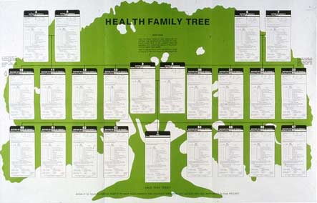
Family Medical History !
Never thought it’s so important

Slide 8
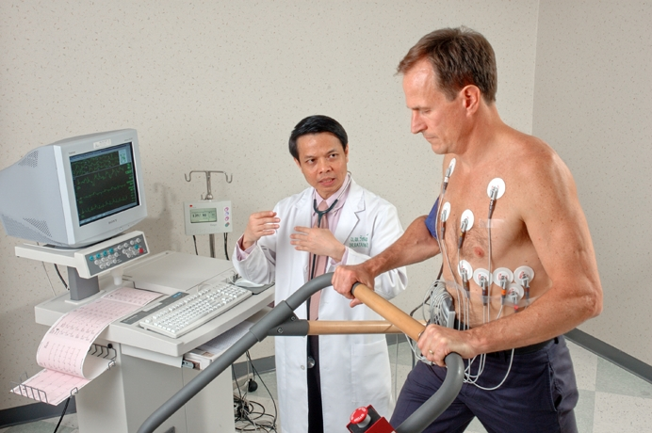
Don’t remember when I had my last routine health Check up?

Slide 9


Too Much work! Can I connect to doctor Online ?

Slide 10
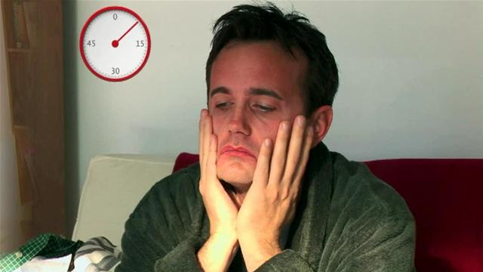
How do I manage all ?

Slide 11

Do not worry..
We are here now to take care of you..

